Slide 1






Slide 2


Section Summary
Classical Cryptography
Cryptosystems
Public Key Cryptography
RSA Cryptosystem
Fermat’s Little theorem

Slide 3
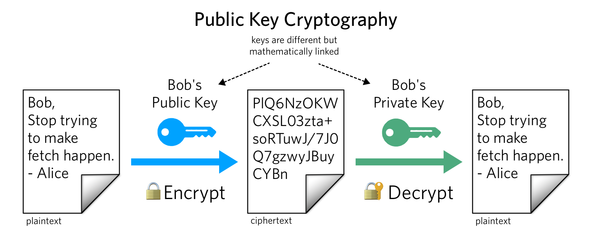
Public key/ Asymmetric key cryptography

Slide 4
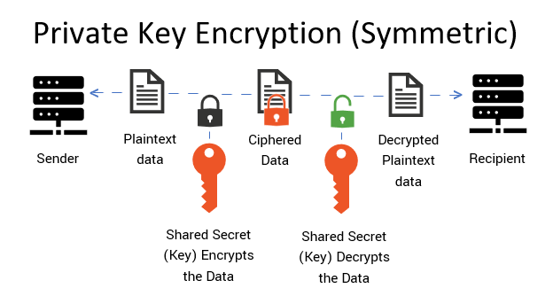
Symmetric Key / private Key Cryptography

Slide 5

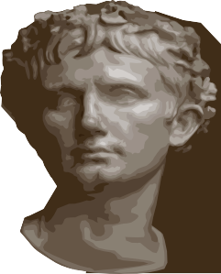
Caesar Cipher
Julius Caesar created secret messages by shifting each letter three letters forward in the alphabet (sending the last three letters to the first three letters.) For example, the letter B is replaced by E and the letter X is replaced by A. This process of making a message secret is an example of encryption.
Here is how the encryption process works:
Replace each letter by an integer from Z₂₆, that is an integer from 0 to 25
representing one less than its position in the alphabet.
The encryption function is f(p) = (p + 3) mod 26. It replaces each integer p in
the set {0,1,2,…,25} by f(p) in the set {0,1,2,…,25} .
Replace each integer p by the letter with the position p + 1 in the alphabet. Example: Encrypt the message “MEET YOU IN THE PARK” using the Caesar cipher.
Solution: 12 4 4 19 24 14 20 8 13 19 7 4 15 0 17 10.
Now replace each of these numbers p by f(p) = (p + 3) mod 26.
15 7 7 22 1 17 23 11 16 22 10 7 18 3 20 13.
Translating the numbers back to letters produces the encrypted message
“PHHW BRX LQ WKH SDUN.”

Slide 6
Caesar Cipher
To recover the original message, use f⁻¹(p) = (p−3) mod 26. So, each letter in the coded message is shifted back three letters in the alphabet, with the first three letters sent to the last three letters. This process of recovering the original message from the encrypted message is called decryption.
The Caesar cipher is one of a family of ciphers called shift ciphers. Letters can be shifted by an integer k, with 3 being just one possibility. The encryption function is
f(p) = (p + k) mod 26
and the decryption function is
f⁻¹(p) = (p−k) mod 26
The integer k is called a key.

Slide 7

Shift Cipher
Example 1: Encrypt the message “STOP GLOBAL WARMING” using the shift cipher with k = 11.
Solution: Replace each letter with the corresponding element of Z₂₆.
18 19 14 15 6 11 14 1 0 11 22 0 17 12 8 13 6.
Apply the shift f(p) = (p + 11) mod 26, yielding
3 4 25 0 17 22 25 12 11 22 7 11 2 23 19 24 17.
Translating the numbers back to letters produces the ciphertext
“DEZA RWZMLW HLCXTYR.”

Slide 8

Shift Cipher
Example 2: Decrypt the message “LEWLYPLUJL PZ H NYLHA ALHJOLY” that was encrypted using the shift cipher with k = 7.
Solution: Replace each letter with the corresponding element of Z₂₆.
11 4 22 11 24 15 11 20 9 11 15 25 7 13 24 11 7 0 0 11 7 9 14 11 24.
Shift each of the numbers by −k = −7 modulo 26, yielding
4 23 15 4 17 8 4 13 2 4 8 18 0 6 17 4 0 19 19 4 0 2 7 4 17.
Translating the numbers back to letters produces the
decrypted message
“EXPERIENCE IS A GREAT TEACHER.”

Slide 9
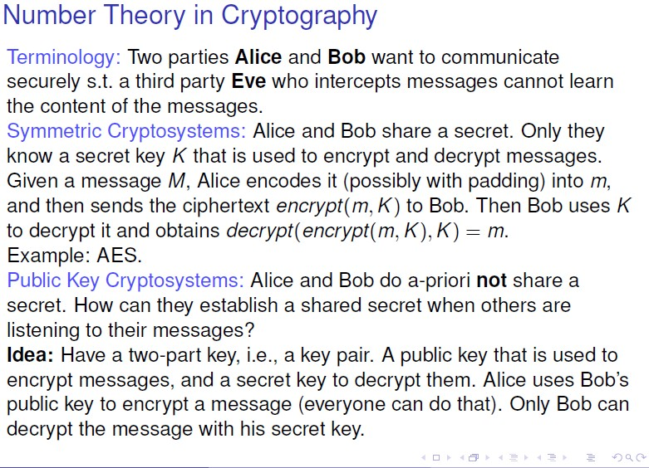
Rivest–Shamir–Adleman (RSA)

Slide 10
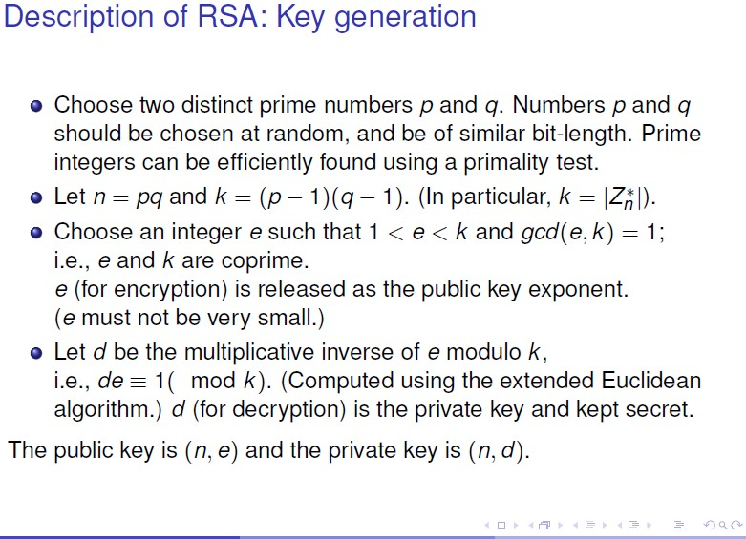

Slide 11
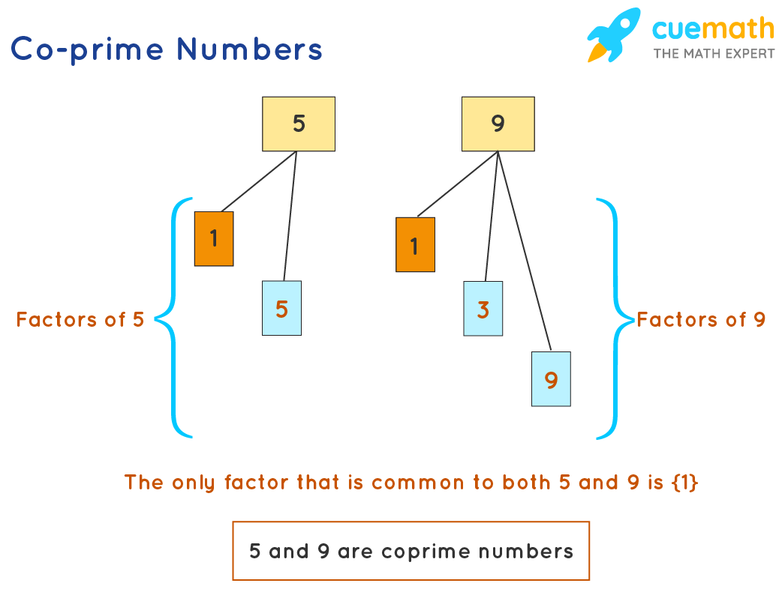

Slide 12
Key Generation of RSA
Choose two distinct primes p and q randomly, but p and q must have same bit length
We can find prime number easily with the help of primality test.
The we calculate n = p.q
The we calculate k = (p-1) (q-1)
Chose an e, such that 1<e <k and gcd(e, k)=1 i.e and e and k must be co prime (relatively prime)
e is released as the public exponent, e must not be very small
d must be the multiplicative inverse of e mod k
e is used for encryption and d is used for decryption
The public key is (n, e ) and the private key is (n,d)

Slide 13
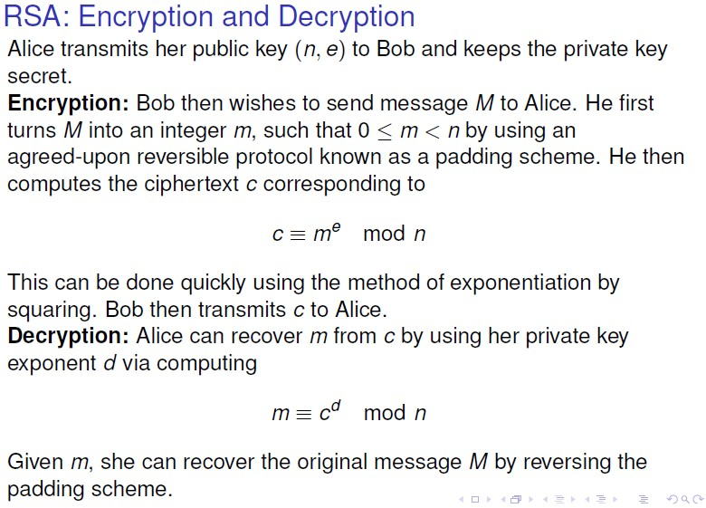

Slide 14

Using RSA
Given pubKey = <e, n> and privKey = <d, n> If Message = m
Then:
encryption: c = m^{e} mod n, m < n decryption: m = c^{d} mod n signature: s = m^d mod n, m < n verification: m = s^e mod n
8. Cryptography part 2
153

Slide 15

Example of RSA (1)
mtholyoke.edu/courses/quenell/s2003/ma139/js/powermod.html
Choose p = 7 and q = 17. Compute n = p*q= 119.
Compute f(n)=(p-1)(q-1)=96.
Select e = 5, (a relatively prime to f(n).) Compute d = _77_such that e*d=1 mod f(n).
Public key: <5,119>
Private key: <77,119>
Message(m) = 19
Encryption: 19⁵ mod 119 = 66
Decryption: 66⁷⁷ mod 119 = 19
s = m^d mod n
S = 19 ^ 77 mod 119 = 66
m = s^e mod n
m = 66 ^ 5 mod 119 = 19
8. Cryptography part 2
154

Slide 16

Example of RSA (2)
p = 7, q = 11, n = 77
Alice chooses e = 17, making d = 53
Bob wants to send Alice secret message HELLO (07 04 11 11 14)
– 07¹⁷ mod 77 = 28; 04¹⁷ mod 77 = 16
– 11¹⁷ mod 77 = 44; – 11¹⁷ mod 77 = 44
– 14¹⁷ mod 77 = 42
Bob sends 28 16 44 44 42
8. Cryptography part 2
155

Slide 17
Example of RSA (3)
Alice receives 28 16 44 44 42
Alice uses private key, d = 53, to decrypt message:
– 28⁵³ mod 77 = 07; 16⁵³ mod 77 = 04
– 44⁵³ mod 77 = 11; 44⁵³ mod 77 = 11
– 42⁵³ mod 77 = 14
Alice translates 07 04 11 11 14 to HELLO
No one else could read it, as only Alice knows her private key (needed for decryption)
8. Cryptography part 2
156

